Slide 1
Build Python Distributed Applications by SocketPro
Yuancai (Charlie) Ye
www.udaparts.com

Slide 2
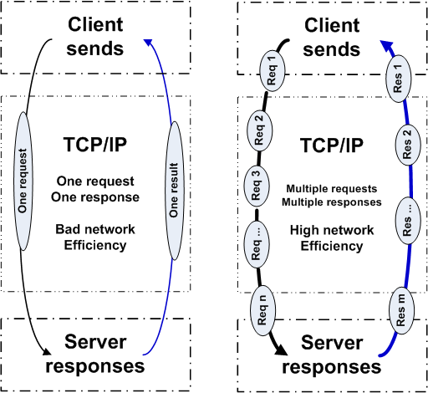
One vs multiple concurrency processing

Slide 3
SocketPro Communication Architecture and Components
Client Core
cross-platform
native code
Server Core
cross-platform
native code
Request batching, asynchrony, parallel communication on TCP/IP
C++
Adapter
.Net
Adapter
JavaScript
Adapter
Python
Adapter
Java
Adapter
PHP
Adapter
C++
Adapter
.Net
Adapter
Python
Adapter
Java
Adapter
User Client Code
User Server Code

Slide 4
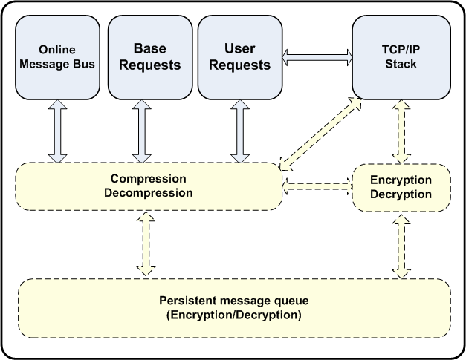
Client Core

Slide 5
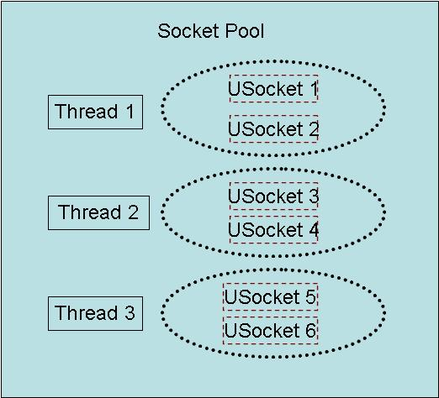
Client Socket Pool
SocketPro provides loading balancing through persistent queue at client side, and routing service at server side

Slide 6
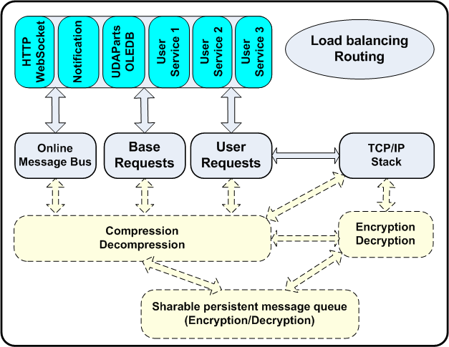
Server Core

Slide 7
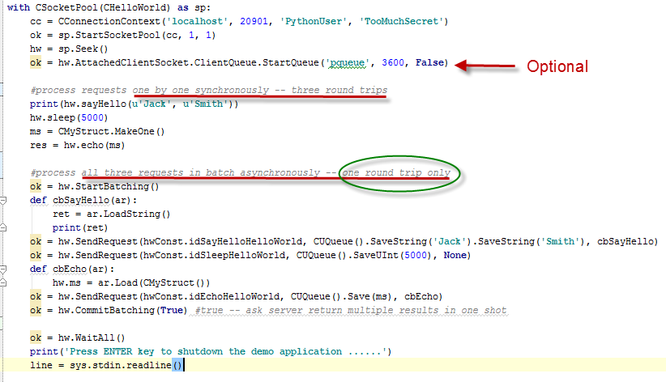
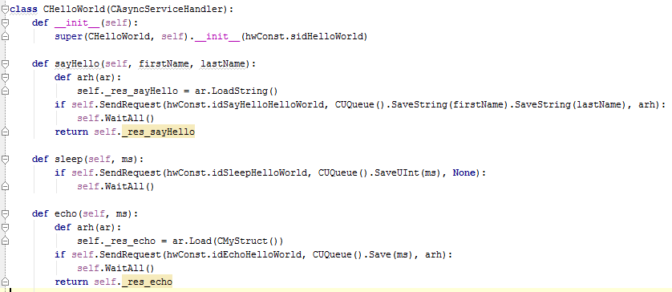
Hello World – Python Client Side

Slide 8
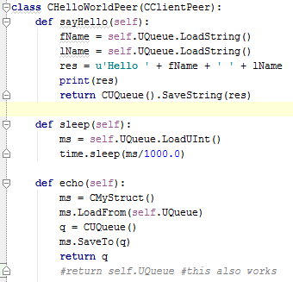
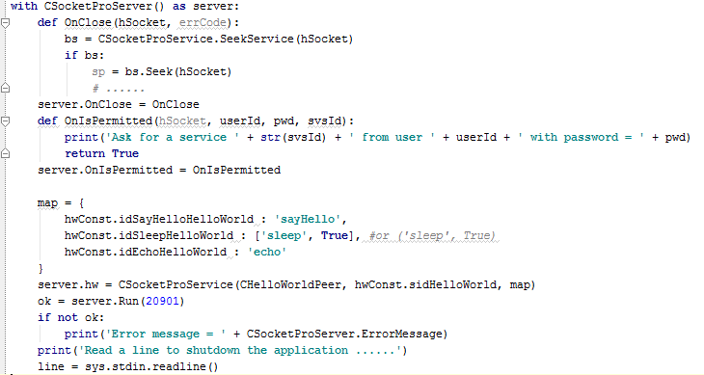
Hello World – Python Server Side

Slide 9
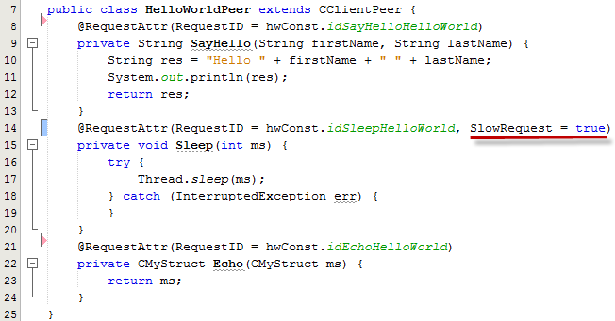
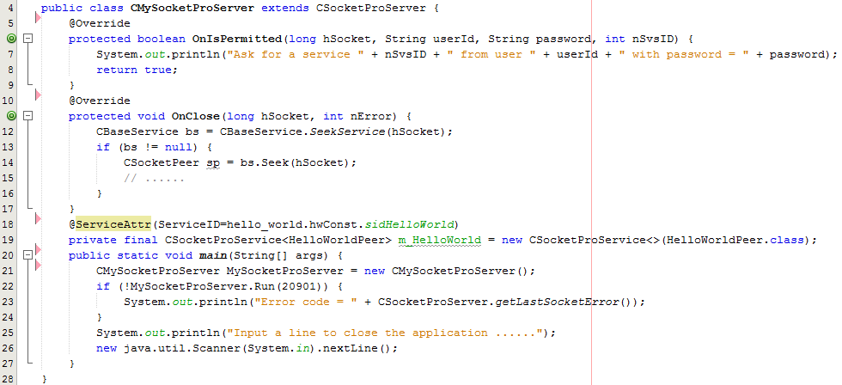
Hello World – Java Server Side

Slide 10
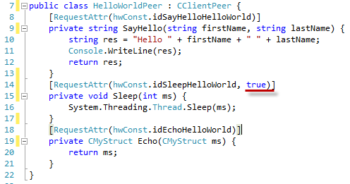
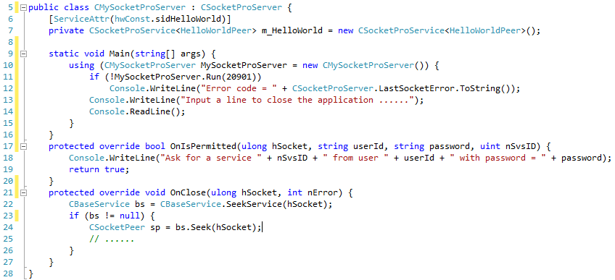
Hello World – C# Server Side

Slide 11
SocketPro Integrated Communication Models
Client/server model
Bi-directional messaging push (subscribe/publish pattern)
Routing/Loading balance with auto-fault recovery and session affinity
Bi-directional persistent queue (client and server)
Replication with ACID
Async (default), requests batching, and sync

Slide 12
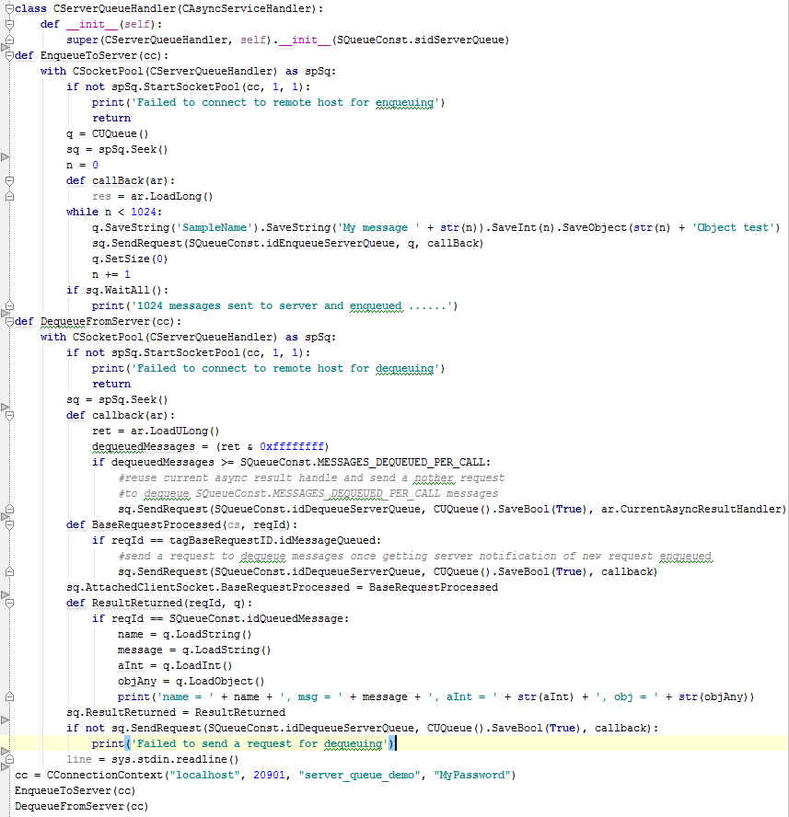
Server Queue – Python Client Side

Slide 13
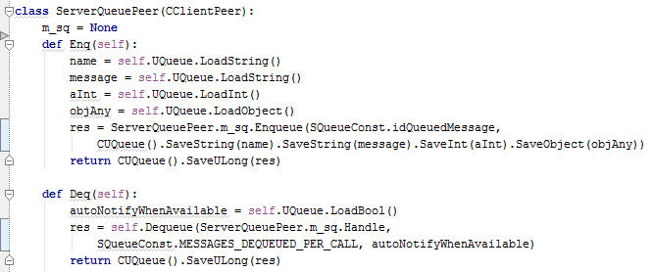
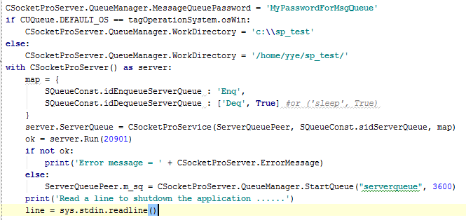
Server Queue – Python Server Side

Slide 14
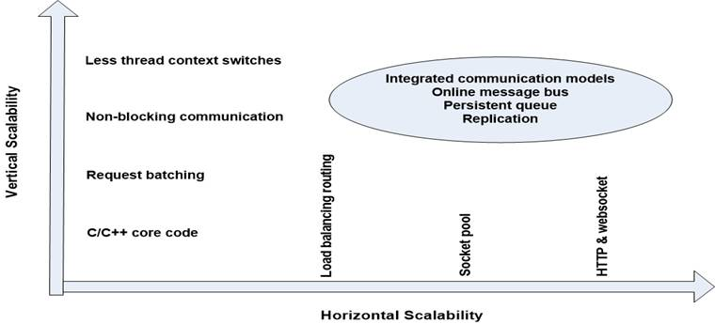
SocketPro Scalabilities

Slide 15
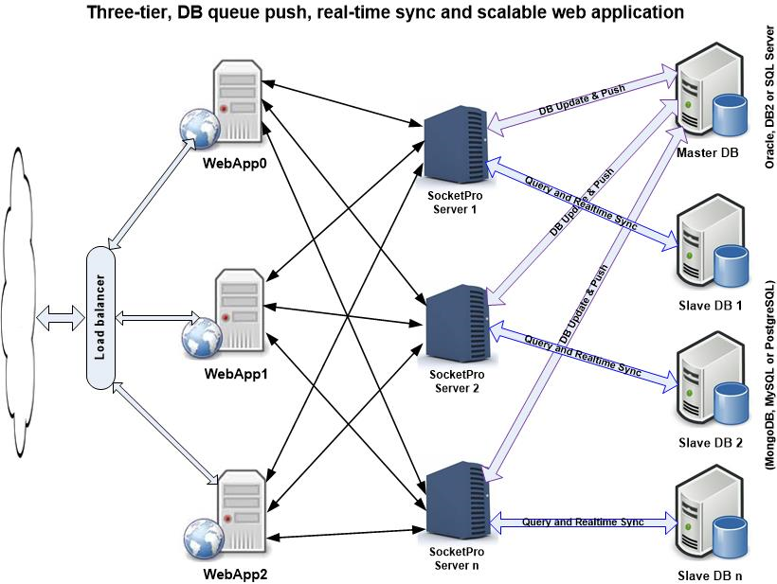
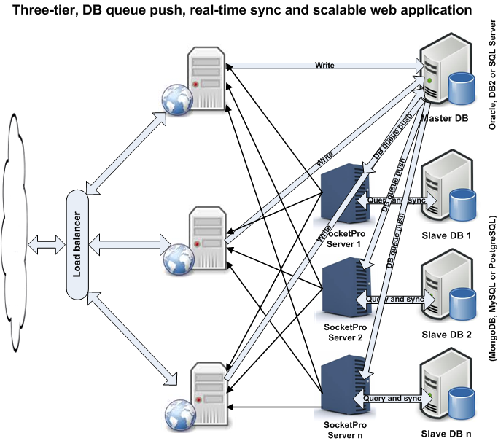

Slide 16
SocketPro Key Advantages
An ACF (Async Communication Framework) on TCP/IP
One port for integrated communication models and multiple services
Superior latency, performance and scalability
Cross operation systems and cross development languages supported
Simplicity and fast development
Great for challenging tasks (unstable WAN, large collection items, cache real-time update and small messages)
Great freedom to architecture design and development
Persistent queue for data replication, fault-tolerance and data durability
Secure (SSL3/TLSv1)

Slide 17
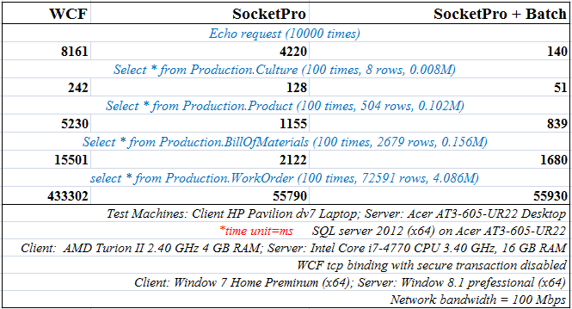
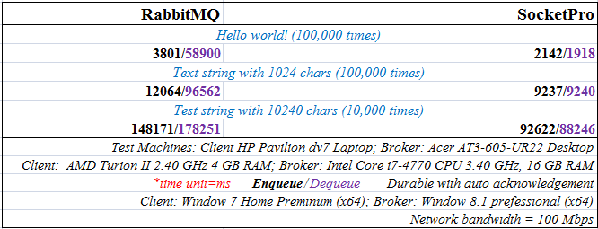
Great Performance
Always

Slide 18
